Slide 1
R Project
Movie Success Rate Prediction
Batch No: 9
Skandan . K . A
Manoj Mahesh Patil

Slide 2
Libraries used:
library(ggplot2) // Used to plot different graphs.
library(dplyr) //Used for data manipulation.
library(statsr) //Used for sampling distributions , hypothesis testing etc.,
library(gridExtra) //Merge two graphs
library(corrplot) //Used to plot the graph for correlation matrix.

Slide 3
Data Pre-Processing:
Then we read the csv file:
> movies<- read.csv("movie_metadata.csv",header = T,sep = ",")
> dim(movies)
[1] 5043 28
1] We remove the duplicated rows from the data set.
> movies<- movies[!duplicated(movies) , ]

Slide 4
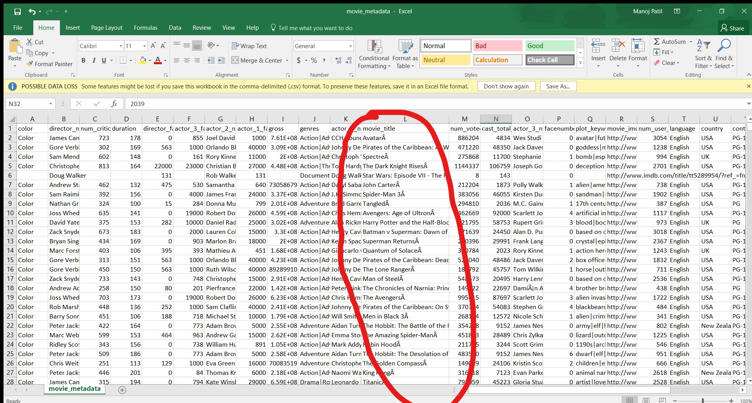

Slide 5
2] As you can see ,each row from the movie_title column from our csv file ends with a special character(Â) and also has some blank white spaces in it.
So we are going to remove them and shift them towards the right of their respective cell.
For this we are going to use the library "strigr".
library(stringr)
> movies$movie_title <- gsub("Â", "", as.character(factor(movies$movie_title)))
> str_trim(movies$movie_title, side = "right")
3] We check whether the data set has any missing values or not
> which(!complete.cases(movies))
This gives the number of the rows which have missing values.
So, we remove these missing values
> movies <- na.omit(movies)
> dim(movies)
[1] 3801 28

Slide 6
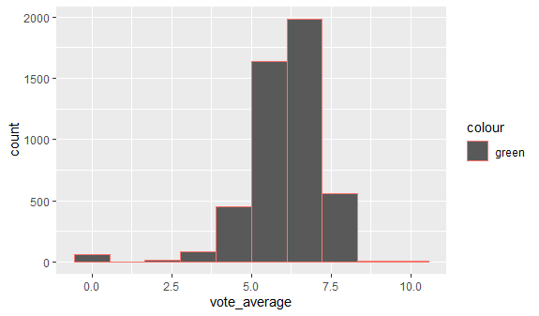
Visualization:
1] Vote Average of Movies:
Out of a 5000 movies in the dataset only a
few have crossed the 7.5 mark on “TMDB”.
Majority of the movies are rated between 5.5 and 7.5 .Majority of these movies are Commercial.
As you can, out of even these few movies a vey few have got 10 ,but we can’t see that in the graph as the frequency is very high.

Slide 7
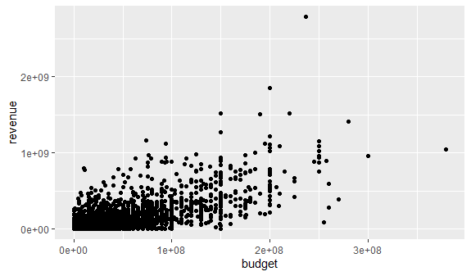
2] Budget v/s Revenue of a Movie
This plot shows the correlation between the budget of making the movie v/s the revenue it has generated.
As you can see most of the low budget movies have a very low revenue . This might be because of the small scale promotion of the movie and/or maybe because of it’s release in lesser number of theatres.
The graph almost shows a linear relation.

Slide 8
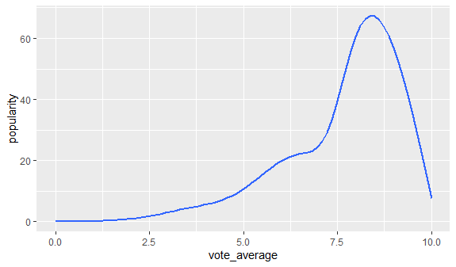
3] Vote Average v/s Popularity :
This is a plot of Vote average the movie has received v/s The popularity of the movie.
The plot is almost linear , i.e , as the vote average increases , the popularity also increases .
But as we go on , in the end , there is a sudden steep decrease in the popularity. This maybe because , as we said earlier the Documentaries are the ones which receive a very good rating , and also these Documentaries are very less popular when compared to the people attracting Commercial Movies .

Slide 9
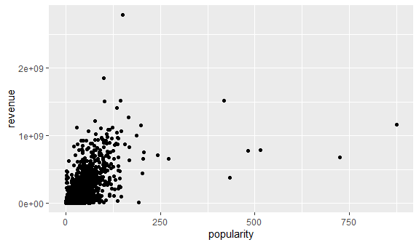
4] Popularity v/s Revenue:
This is a plot of Popularity of the movie v/s Gross Revenue it has generated.
The scatter plot almost has a linear relation.

Slide 10
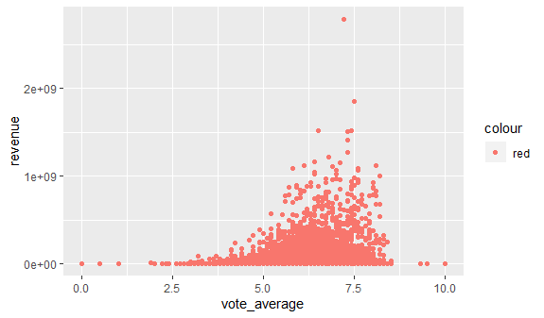
5] Vote Average v/s Revenue:
This plot is of the Rating of the movie v/s the Revenue it has generated .
As we can see from the graph that:
1] Movies with low vote average haven’t financially done well in the box office.
2] Movies with mediocre rating are the ones which have generated higher revenue. These mediocre rated movies belong to action , sci-fi and commercial genres.
3] Movies with the highest rating i.e above 7.5 haven’t done well when compared to those with a rating b/w 5.5 to 7.5. This is because these movies are either Biographies or Documentaries , which very less people tend to go out and actually watch it in theatres.

Slide 11
Abstracting the data of the potential predictors for the model.
> movies.new <- movies%>%select(director_name,num_critic_for_reviews,duration,gross,genres,movie_title,num_voted_users,budget,imdb_score)
Now we split the data set into 2 , "train" and "test".
The "train" data set is almost of the same size of original data set and the "test" dataset is only of fewer number of rows.
We use the "train" data set to create the prediction model and the "test" data set to test our prediction model
>set.seed(2017)
> split <- sample(seq_len(nrow(movies.new)), size = floor(0.999 * nrow(movies.new)))
> train <- movies.new[split, ]
> test <- movies.new[-split, ]
> dim(train)
[1] 3797 9
> dim(test)
[1] 4 9

Slide 12
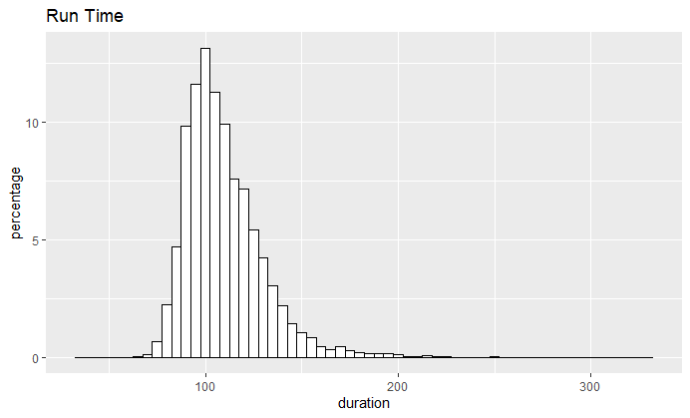
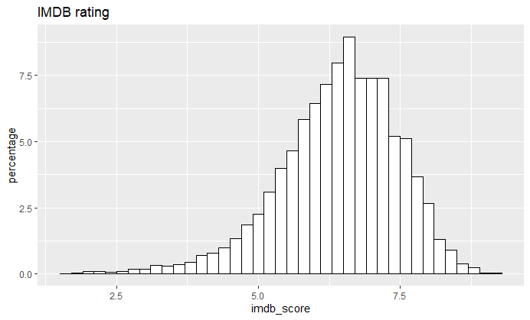
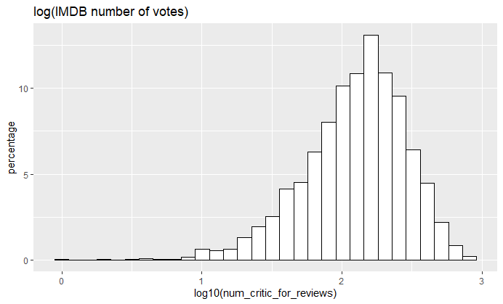
Run time , IMDB rating and Number of Votes all have reasonable broad distribution hence they will be considered for regression analysis.

Slide 13
> p1 <- ggplot(aes(x=duration), data=train) +
+ geom_histogram(aes(y=100*(..count..)/sum(..count..)), color='black', fill='white', binwidth = 5) + ylab('percentage') + ggtitle('Run Time')
> p1
> p2 <- ggplot(aes(x=imdb_score), data=train) +
+ geom_histogram(aes(y=100*(..count..)/sum(..count..)), color='black', fill='white', binwidth = 0.2) + ylab('percentage') + ggtitle('IMDB rating')
> p2
> p3 <- ggplot(aes(x=log10(num_critic_for_reviews)), data=train) +
+ geom_histogram(aes(y=100*(..count..)/sum(..count..)), color='black', fill='white') + ylab('percentage') + ggtitle('log(IMDB number of votes)')
> p3

Slide 14
Model Making:
Here the criteria for selecting the predictor is that:
(1) The R squared and Adjusted R Squared must be significant
(2) p value should be near to zero (i.e < 0.05 ).
>fit1 <- lm(budget ~ gross, data=train)
>summary(fit1)
>fit2 <- lm(imdb_score ~ gross , data=train)
>summary(fit2)
>fit3<-lm(imdb_score~gross+budget+num_critic_for_reviews,data = train)
>summary(fit3)
The R squared value and the Adjusted R squared value are significant and close to zero,
Hence we select budget,imdb_score and number of critic reviews as predictors.

Slide 15
PREDICTION:
We use the fit3 model to predict the imdb_scores of the rows of test data set.
>newmovie<-test%>%select(gross,budget,num_critic_for_reviews)
>predict(fit3,newmovie)
364 1048 2097 3910
6.907984 6.302471 6.056702 6.052411
Now we take the values from test data set
> test$imdb_score
[1] 7.0 6.4 7.4 4.6
As we can see the values almost match , so the model which we have made holds good.

Slide 16
Thank you!!!

